Slide 1



Text Sentimental Analysis With Speech Recognition
Machine Learning Course – Dr. Sara Sweidan \ Eng. Ibrahim Reyad
Course Project – 2022/2023

Slide 2
Team Work:
يوسف طارق عبدالمعبود البارودى
علي أسامة عابدين عمر | حنين أمجد احمد فؤاد عمر
مهند أيمن صلاح عبدالفتاح | آية الله هشام كمال
رومانى نصرت شوقي جرجس | مها مصبح عبدالله مصطفى

Slide 3
AGENDA
Data Gathering & EDA
Preparation & Cleaning
Preprocessing & Vectorization
Modeling & Train
Evaluation & Compare

Slide 4
Introduction
This project is about implementing Sentimental Analysis on English Voiced-Text, thanks for using Sentiment dataset with 1 million tweets & YouTube Statistics Dataset
Both datasets are used for the variations of Positive & Negative expressions for different situations on social media, whether it is a feedback, expressing feelings, discussions and lot more, and that's obviously is easy with today SOCIAL MEDIA.
nowadays, there are many efforts to make controlling machines easier, i.e. controlling machines with voice instead of typing some shell commands, even sharing your own feelings with voice instead of typing some words, express your feedback as much as you want !
TO DEFINE IT MORE CLEARLY, our problem is to Analyze (Classify) the sentiment of our English Voiced-Text if it is Positive or Negative, which is Binary Classification

Slide 5
A little about our Datasets
Dataset | Sentiment Dataset with 1M tweets | YouTube Statistics
No. of Records | 1 Million Records | 18.4 K Records
Usability | Tweets Sentimental Analysis | EDA & Sentiment Analysis
Labeled | Yes | Yes
Classes | Positive/ Negative / Uncertain/ Litigious | Positive/ Negative / Neutral
Balanced | Yes | No
Distribution | Language-based | Comment-Like based
Comparison

Slide 6
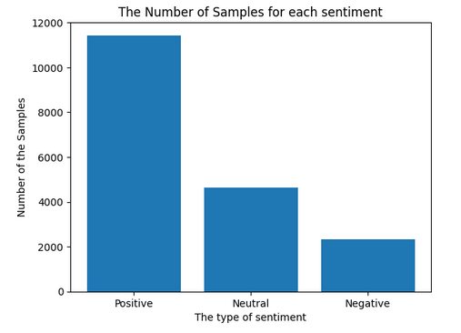
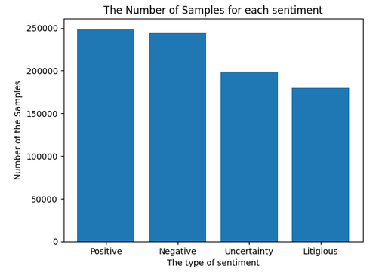
Data Gathering & Exploratory Data Analysis
YouTube Statistics:
The dataset labels are displayed to show how they are distributed on the existed classes
All Duplications and Null Values are removed
The Comments Section only is taken, there is no need for the other parts of the dataset
Only the Positive & Negative labeled rows are taken.
Tweets Sentiment:
The dataset labels are displayed to show how they are distributed on the existed classes.
All Duplications and Null Values are removed.
The Text (Content of tweet) are taken with its corresponding label.
Only the Positive & Negative labeled rows are taken.
Only The English-based tweets are taken.

Slide 7

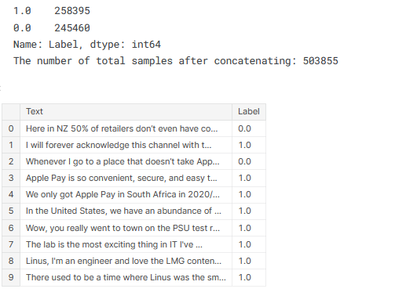
Concatenating Both Datasets

Slide 8
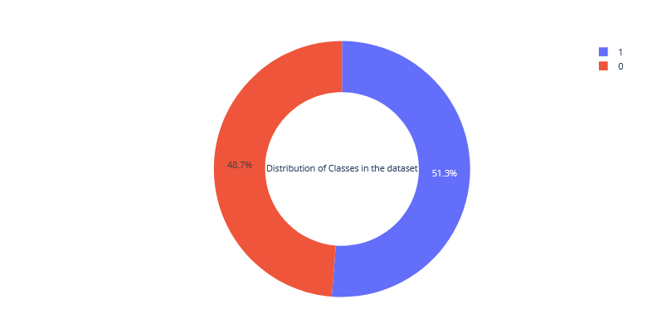
Distribution of the Corpus
Positive
Negative

Slide 9
Problems In the Corpus
It is expected to face some troubles using Social Media comments & tweets for training, which is the dataset may contain:
Mentions @
Hashtags #
Emojies and Flags
Links & URLs
Symbols
Digits which is useless at our problem
Duplicated characters within the same word
Abbreviations
It is all useless for our problem

Slide 10
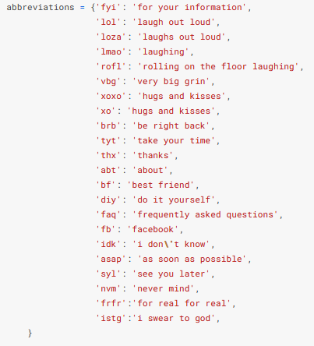
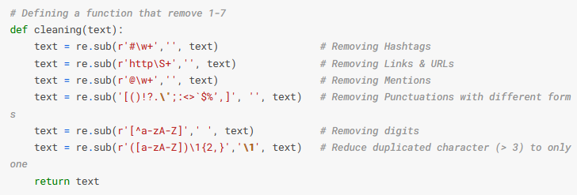
Data Preparation & Cleaning

Slide 11
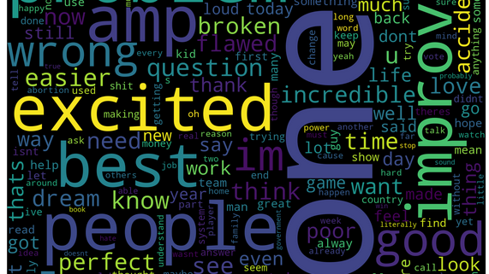
What is the Most frequent Words ?

Slide 12
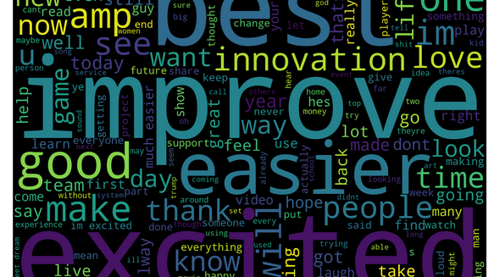
What is the Most frequent Words for Positive Indicator ?

Slide 13
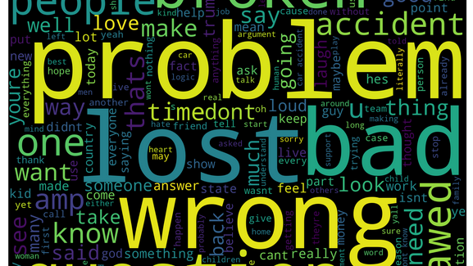
What is the Most frequent Words for Negative Indicator ?

Slide 14
Data Preprocessing
Some Preprocessing techniques are used to make the training phase more efficient, leading to higher accuracy
Starting with the Tokenization, which is one of the very useful techniques for further processes
Removing all the stop words such as (for – in – on – the ... Etc) which is not affecting the output explicitly.
Part-of-Speech Tagging (POS), which indicates what was the position of each word within the sentence.
Lemmatization with POS, which is taking each word and reduce it to the original form BASED on the POS tagging that has been taken before.

Slide 15
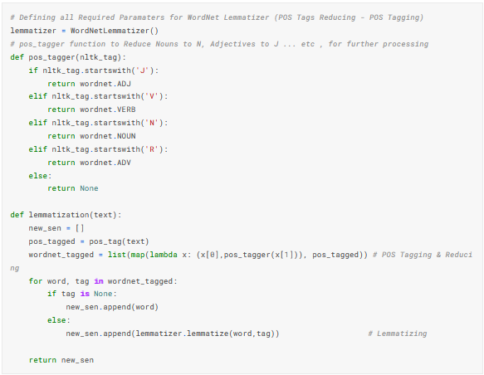
Data Preprocessing

Slide 16
Representation & Vectorization
TF-IDF Vectorization
For our problem, i.e. Sentiment Analysis & Classification, the most appropriate representation would be TF-IDF Vectorizer, it provide more accurate correlation between words (Features) and how they are appeared within the whole corpus.
The results of this work show that calculating the TF-IDF score of the corpus allows for a more accurate representation of the overall polarity since terms are given a weight based on their uniqueness and relevance rather than just the frequency at which they appear in the corpus.

Slide 17
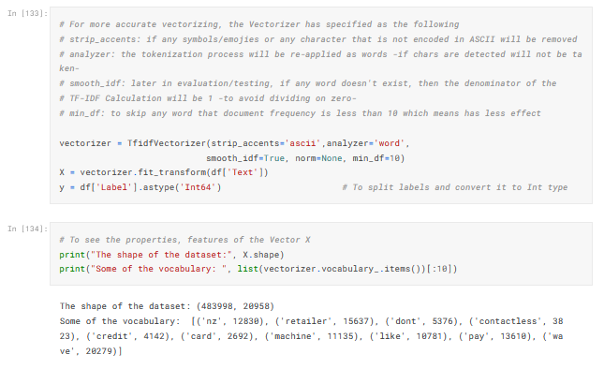
Representation & Vectorization

Slide 18

Modeling & Training
There are 5 models that is trained and evaluated with Fine Tuning to get the best performance of each model, and they are the following:
Random Forest Classifier
Logistic Regression Classifier
Multi-Nomial Naïve Bayes
Decision Tree Classifier
Linear Support Vector Classifier

Slide 19
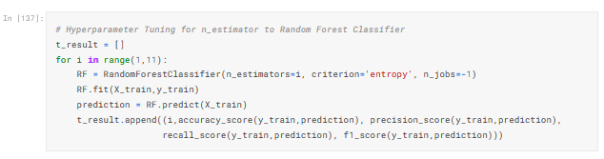
Random Forest Classifier - Tuning

Slide 20
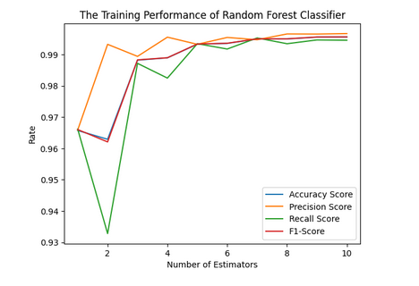
Random Forest Classifier Performance

Slide 21
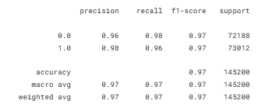
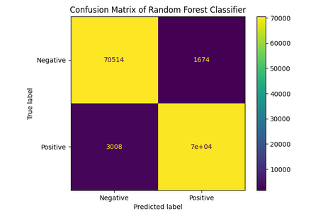
Report & Confusion Matrix

Slide 22
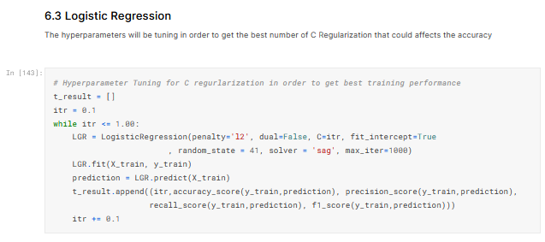
Logistic Regression Classifier - Tuning

Slide 23
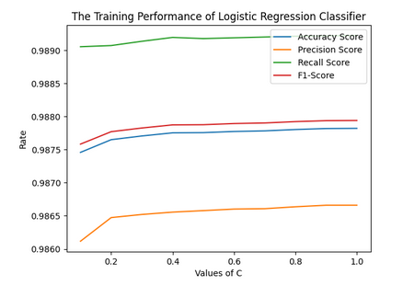
Logistic Regression Classifier Performance

Slide 24
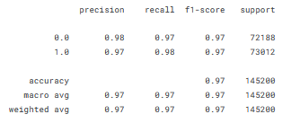
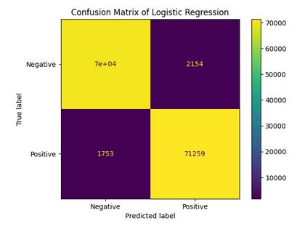
Report & Confusion Matrix

Slide 25
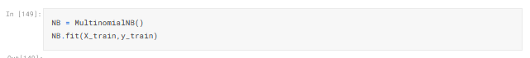
Multinomial Naïve Bayes

Slide 26
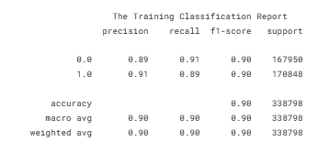
Multinomial Naïve Bayes Performance

Slide 27
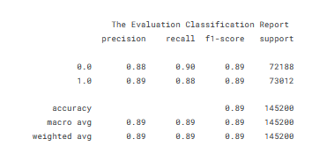
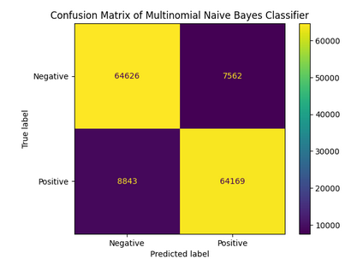
Report & Confusion Matrix

Slide 28
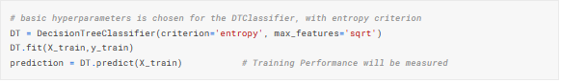
Decision Tree Classifier

Slide 29
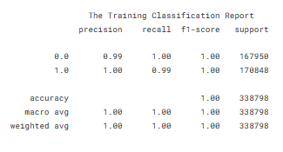
Decision Tree Classifier Performance

Slide 30
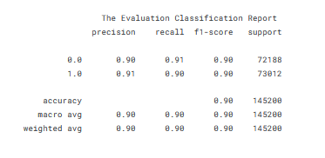
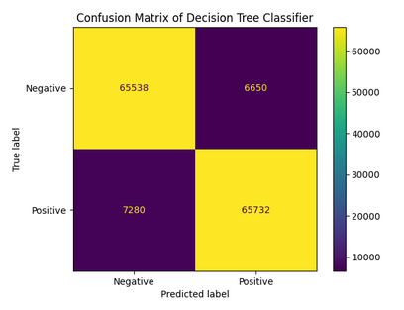
Report & Confusion Matrix

Slide 31
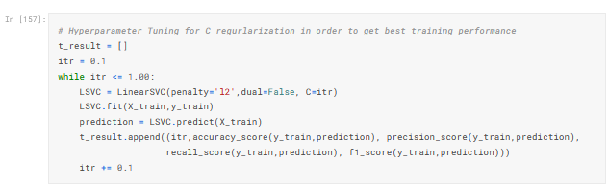
Linear Support-Vector Classifier - Tuning

Slide 32
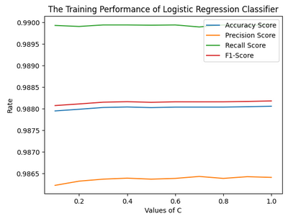
Linear Support-Vector Classifier Performance

Slide 33
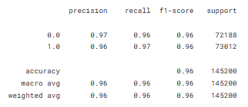
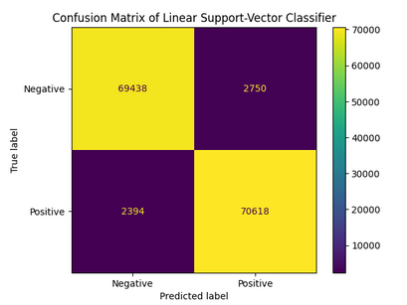
Report & Confusion Matrix

Slide 34
Comparison & Testing Evaluation
# | Model Name | Accuracy | Precision | Recall | F1-Score
1 | Random Forest Classifier | 96.7755% | 97.6646% | 95.88% | 96.7641%
2 | Logistic Regression | 97.3092% | 97.0659% | 97.5990% | 97.3317%
3 | Multinomial Naïve Bayes | 88.7018% | 89.4578% | 87.8883% | 88.6661%
4 | Decision Tree Classifier | 90.4063% | 90.8126% | 90.0290% | 90.4191%
5 | Linear SVC | 96.4573% | 96.2518% | 96.7211% | 96.4859%

Slide 35
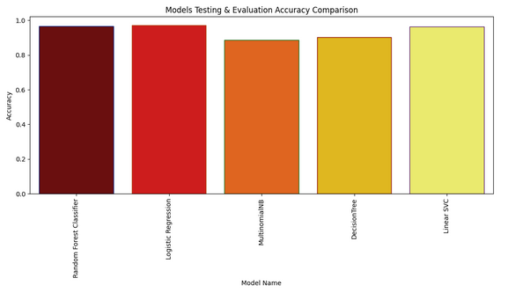
Accuracy-Based Comparison

Slide 36
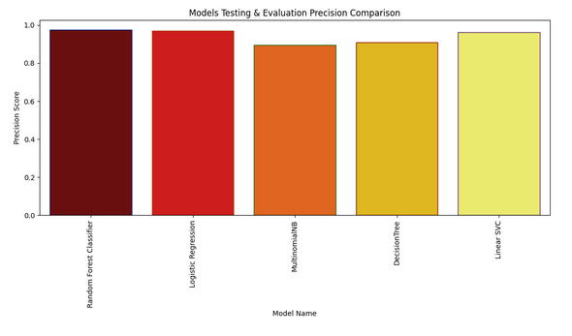
Precision-based Comparison

Slide 37
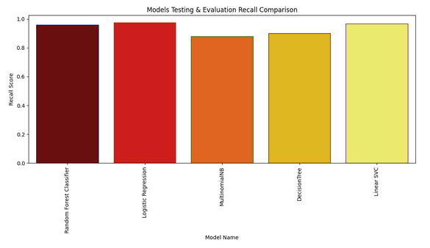
Recall-Based Comparison

Slide 38
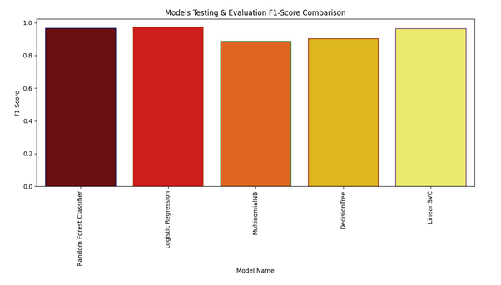
F1-SCORE Comparison

Slide 39

The Most Valuable Model
The Logistic Regression Classifier looks stable and providing the BEST evaluation performance, adding to its training performance displayed before.
So, we are on our way to use Logistic Regression Classifier for our Problem .

Slide 40
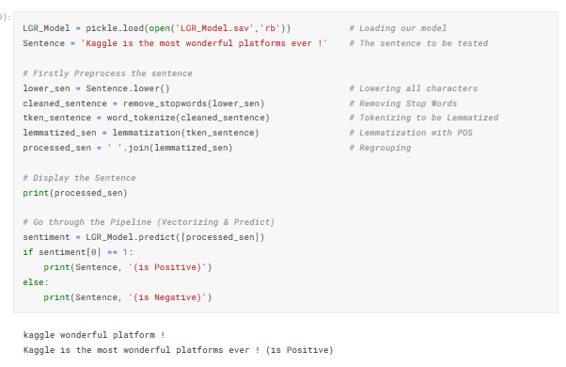
Trying & Testing

Slide 41
On The Other Side (Speech Recognition)
The Python SpeechRecognition Library
Providing Multiple Speech Recognition APIs to use (such as Sphinx, Google, TensorFlow ... Etc)
The ability to get Audio Input from the Microphone and convert it into Digital Audio File
Providing tools for Speech Recognition Processing tools

Slide 42
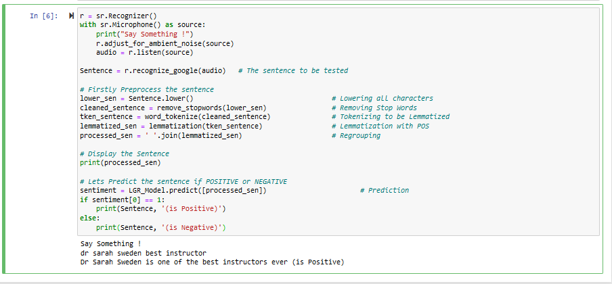
The Whole Thing Integration

Slide 43
End of The Presentation

